Slide 1
Titanic Passenger
Data Analysis
Prepared by Olukotun Damilola
July 2026

Slide 2
OVERVIEW
What We'll Cover
01
Project Objective
Why this analysis was built and what it set out to answer
02
Data & Methodology
The dataset, structure, and Excel techniques used
03
Dashboard Walkthrough
The consolidated, interactive Excel dashboard
04
Key Findings
Demographics, survival, fare, and family patterns
05
Conclusions & Next Steps
What the data tells us, and where to go from here
Titanic Passenger Data Analysis
2

Slide 3
PROJECT OBJECTIVE
Turning Raw Passenger Records Into Insight
This capstone project uses Microsoft Excel to transform a 418 passenger Titanic dataset into a clear, interactive analytical story.
1
Clean and structure a real-world dataset for analysis
2
Build PivotTables across gender, class, age group & embarkation port
3
Create PivotCharts to visualize each summary clearly
4
Assemble every chart into one interactive Excel dashboard
5
Draw data-driven conclusions on who was most likely to survive and why
Titanic Passenger Data Analysis
3

Slide 4
DATA & METHODOLOGY
The Dataset Behind the Dashboard
Dataset Snapshot
Methodology
418
passenger records
Reviewed raw data for completeness (1 missing fare identified)
12
fields per passenger
Built PivotTables summarizing counts & survival by key dimensions
3
ticket classes
Generated PivotCharts directly from each PivotTable
3
embarkation ports
Combined KPIs & charts into one Dashboard sheet
4
age bands
Added Class & Survival slicers for interactive filtering
Fields: Passenger ID, Name, Sex, Age, Age Group, Survived, Class, Siblings/Spouse, Parents/Children, Ticket Number, Fare, Embarkation Port.
Titanic Passenger Data Analysis
4

Slide 5
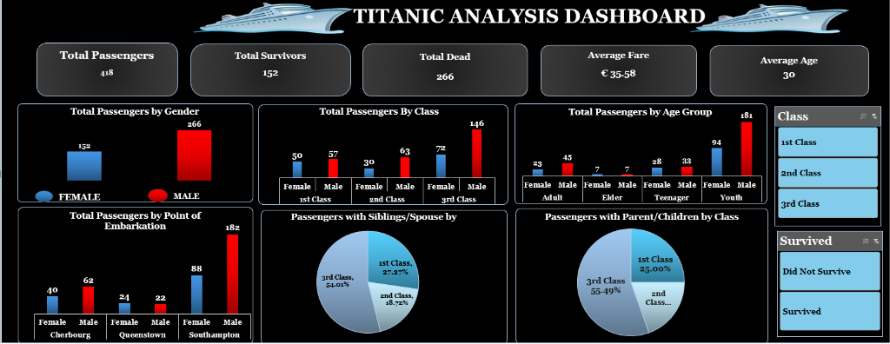
THE DASHBOARD
One View, Every Insight
Titanic Passenger Data Analysis
5

Slide 6
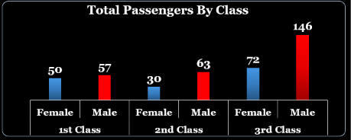
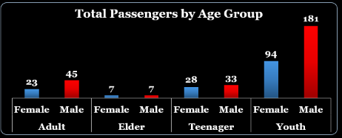
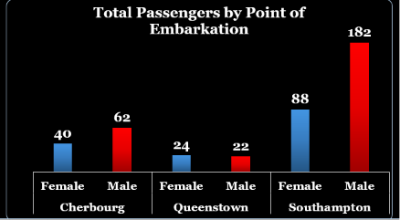
KEY FINDINGS — 01
Who Was Aboard
266 male / 152 female passengers — nearly two-thirds of the manifest was male.
3rd Class was the largest group at 218 passengers (52.2%), more than 1st and 2nd Class combined.
Southampton was the dominant port of embarkation, accounting for 270 of 418 passengers (64.6%).
Titanic Passenger Data Analysis
6

Slide 7
KEY FINDINGS — 02
Survival Was Split Almost Entirely by Gender
100%
0%
of female passengers survived
of male passengers survived
152 of 152
0 of 266
Gender is, by a wide margin, the single strongest predictor of survival in this dataset — outweighing class, age, and fare combined.
Titanic Passenger Data Analysis
7

Slide 8
KEY FINDINGS — 04
Fare Tracked Tightly With Class
Fare Facts
€ 35.58
average fare, all classes
€ 0 – € 512.30
fare range across the manifest
7.6x
1st vs. 3rd Class average fare gap
Right-skewed
distribution — driven by a handful of high 1st Class fares
Titanic Passenger Data Analysis
9

Slide 9
KEY FINDINGS — 05
Families Travelled Overwhelmingly in 3rd Class
Titanic Passenger Data Analysis
10

Slide 10
CONCLUSIONS
What the Data Tells Us
Gender was the dominant survival factor — 100% of female passengers survived vs. 0% of male passengers.
1st Class passengers survived at nearly 1.5x the rate of 2nd or 3rd Class (46.7% vs. ~33%).
3rd Class carried the most passengers but paid the least and survived least — a compounding disadvantage.
Elder and Teenage passengers had the highest survival rates by age group, though on smaller sample sizes.
Southampton, the busiest port, also had the lowest survival rate — driven by its passenger mix.
Titanic Passenger Data Analysis
11

Slide 11
Thank You

